Slide 1
CITY HYGIENE CLEAN ENVIRONMENT,CLEAN MIND,CLEAN WORLD
PRESENTED BY:
B.IMRAN
V.LOURDES INFANT
A.T LIGIN

Slide 2
CITY HYGIENE CLEAN ENVIRONMENT,CLEAN MIND,CLEAN WORLD
GUIDED BY:
MR.BHARATHIDHASAN
ASST.PROFESSOR
DEPARTMENT OF COMPUTER SCIENCE

Slide 3
AGENDA:
ABSTRACTION
SOFTWARE REQUIREMENTS
HARDWARE REQUIREMENTS
EXISTING SYSTEM
PROPOSED SYSTEM
MODULES
DATA FLOW,USE CASE,ENTITY RELATIONSHIP DIAGRAM
FUTURE ENHANCEMENT
CONCLUSION

Slide 4
ABSTRACTION:
CITY HYGIENE IS A MOBILE APPLICATION.
CITY HYGIENE IS A WORLD WIDE SOCIAL NETWORK THAT ALLOW USER TO PARTICIPATE IN THE DEVELOPMENT AND PRESERVATION OF THE ENVIRONMENT OF THEIR CITY.
THE CITIZEN WILL BE ABLE TO EXPRESS HIMSELF ON THE STATE OF HIS ENTOURAGE THROUGH THE APPLICATION AS WELL AS WITHIN OF A COMMITED COMMUNITY.
USERS CAN REPORT A BIN FULL OF WASTE,A PROBLEM ON UNADEQUATE TRASH BINS, REPORT ON GARBAGE SPREAD ON THE ROAD.

Slide 5
SOFTWARE REQUIREMENTS:
OPERATING SYSTEM:WINDOWS,LINUX,MAC OS
PROGRAMMING LANGUAGE:DART LANGUAGE
FRAMEWORK :FLUTTER
DATABASE MANAGEMENT SYSTEM:FIRE DATABASE
TEXT EDITOR (OR)INTEGRATED DEVELOPMENT ENVIRONMENT:ANDROID STUDIO

Slide 6
HARDWARE REQUIREMENTS:
DEVELOPMENT:PC OR LAPTOP
PROCESSOR:INTEL CORE I3 PROCESSOR / HIGHER
HARDDISK:256GB / HIGHER
INTERNET CONNECTIVITY:BROADBAND
MOBILE FOR RESPONSIVE DEVELOPMENT.

Slide 7

EXISTING SYSTEM:
Clean City is a world wide social network that allow users to participate in the development.
Preservation of the environment of their city.
The citizen will be able to express himself on the state of his entourage through the application as well as within of a committed community.

Slide 8

PROPOSED SYSTEM:
CITY HYGIENE IS A MOBILE APPLICATION.
USERS CAN REPORT A BIN FULL OF WASTE,A PROBLEM ON UNADEQUATE TRASH BINS, REPORT ON GARBAGE SPREAD ON THE ROAD.
A MOBILE DRIVEN APPLICATION THAT WILL HELP RESIDENTS LIVING IN THAT AREA TO REGISTER COMPLAINTS REGARDING PICKING UP GARBAGE IN THAT AREA.

Slide 9
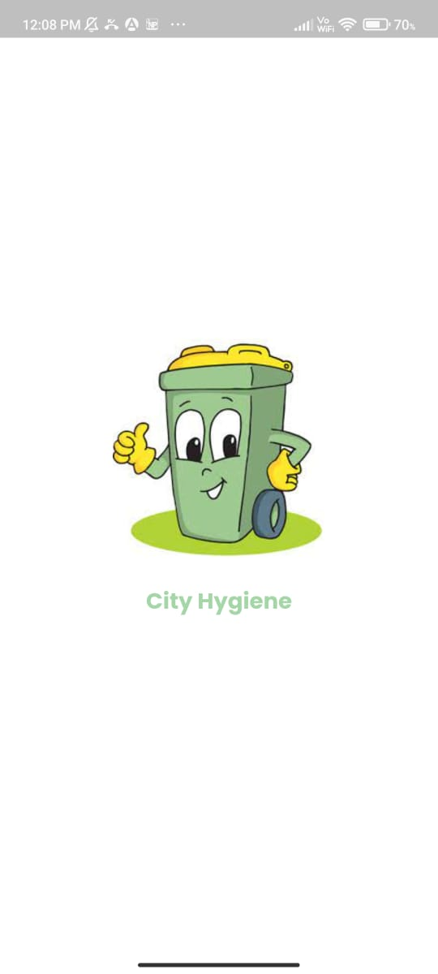
SYSTEM MODULES:
SPLASH SCREEN PAGE:
A splash screen is a graphical control element consisting of a window containing an image, a logo, and the current version of the software. A splash screen can appear while a game or program is launching.

Slide 10

START PAGE:
A start page is an introduction page on a website / application. A splash screen may cover the entire screen or web page; or may simply be a rectangle near the center of the screen or page.

Slide 11
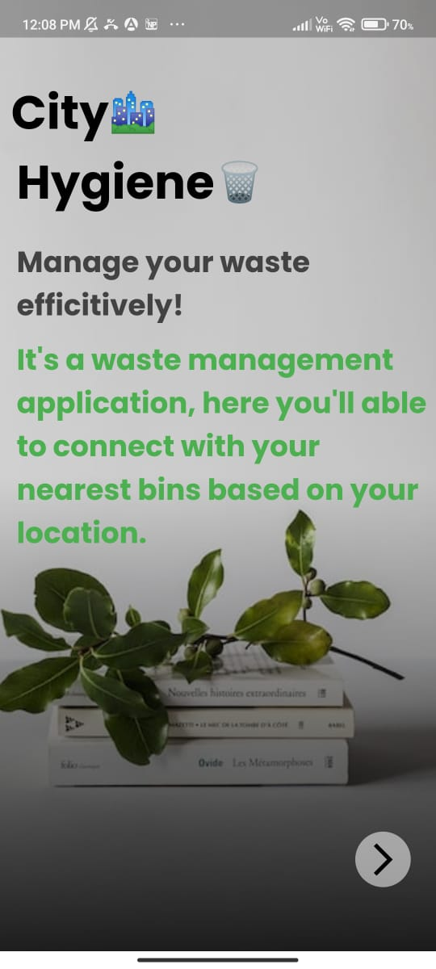
DESCRIPTION PAGE:
The purpose of these pages is to provide information about the file: for example, the author, date of creation, who uploaded the file, any modifications that may have been made, an extended description of the file's subject or context, where the file is used, and license or copyright information. In the case of an image, the file description page shows a higher resolution version of the image, if available.

Slide 12
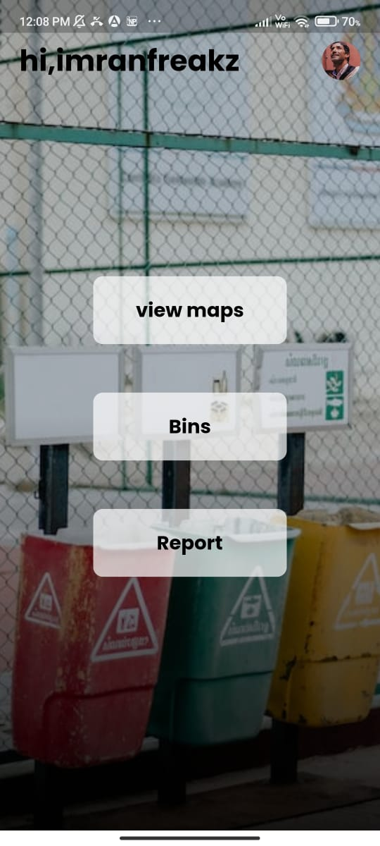
HOME PAGE:
A home page is the primary web page that a visitor will view when they navigate to a website via a search engine, and it may also function as landing page to attract visitors.

Slide 13
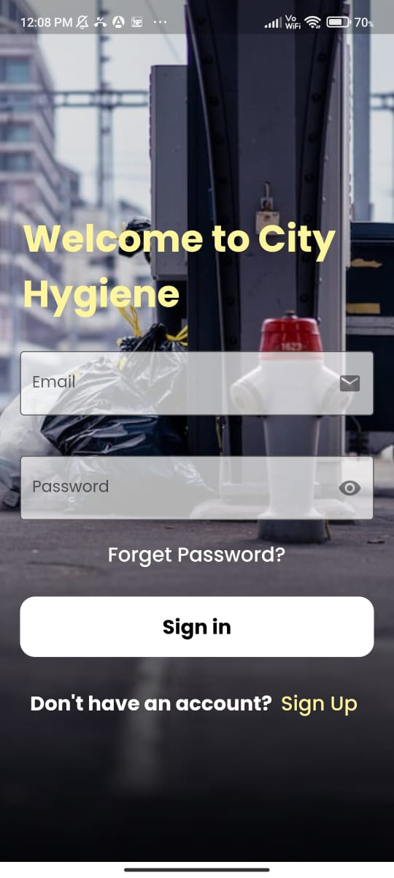
SIGN IN / LOG IN PAGE:
Creating a user account means that you supply a username your real name or a nickname and a password. The system will reject a username that is already in use. A user account is created only once. You are then "logged in". The next time you log in, you supply your username again and demonstrate with the password that you are the same person.

Slide 14
FORGET PASSWORD PAGE
If you have forgotten your password and you previously entered an email address when signing up for the account or in your preferences and you still have access to that email account, then this special page can help you recover access to your account.

Slide 15
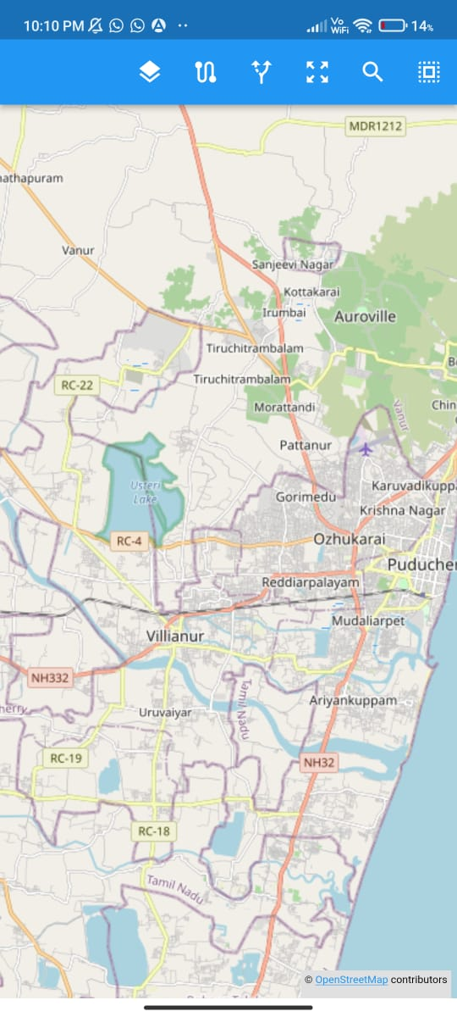
VIEW MAP PAGE:
After Login the app will open the home page. In our Home Page maps will open and it will automatically detect the location.

Slide 16
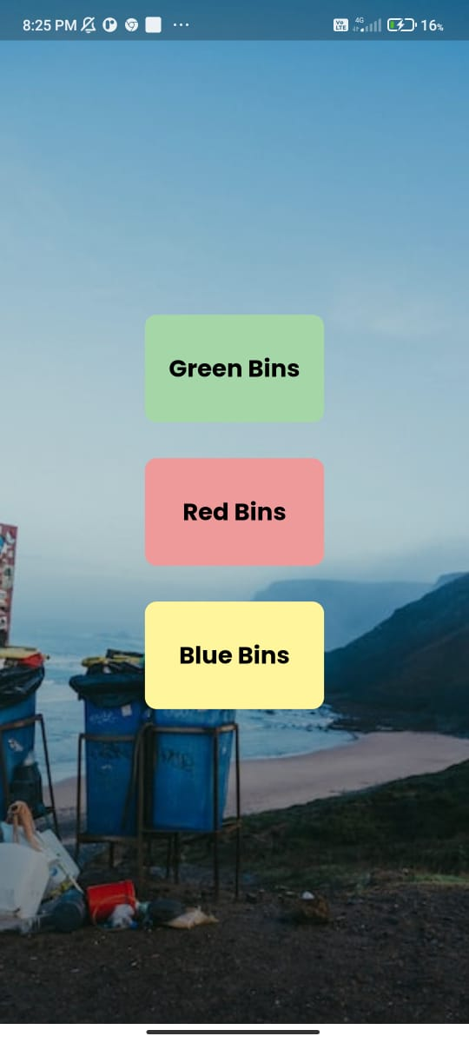
BIN PAGE:
Bin page comprises of three types of bins. They are,
GREEN BIN
RED BIN
BLUE BIN

Slide 17
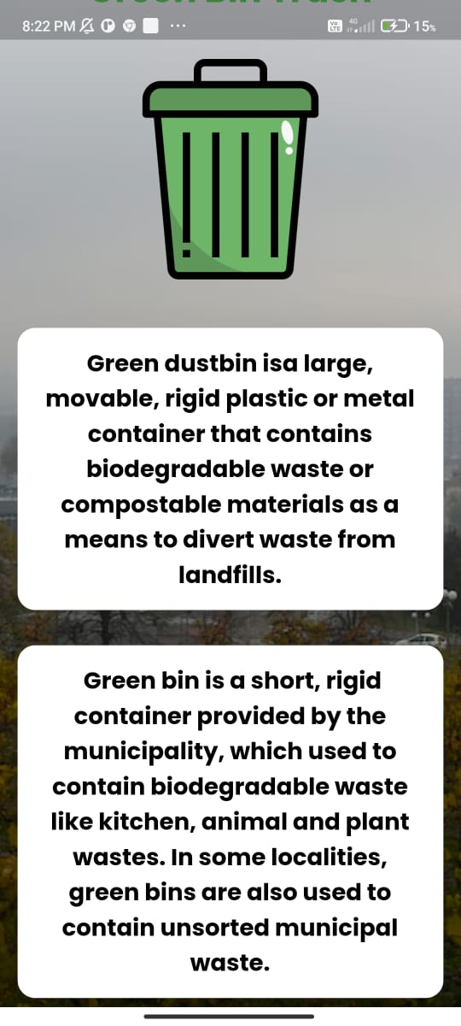
GREEN BIN
Green dustbin is a large movable rigid plastic or metal container that contains biodegradable waste or composable materials such as a means to divert waste from landfills.

Slide 18
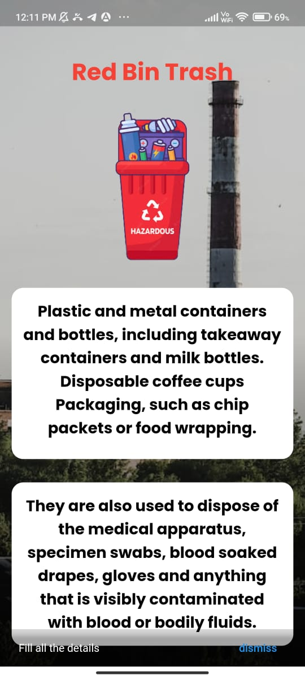
RED BIN:
Plastic coffee cups, packaging, such as chip packets or food wrapping.
They are also used to dispose the medical apparatus specimen, blood soaked drapes, gloves and anything that is visibly contaminated by blood or bodily fluid .
Clothes, rags and shoes are acceptable but always try to donate or give away items in good conditions, Pyrex glass including baking trays and drinking glasses.

Slide 19
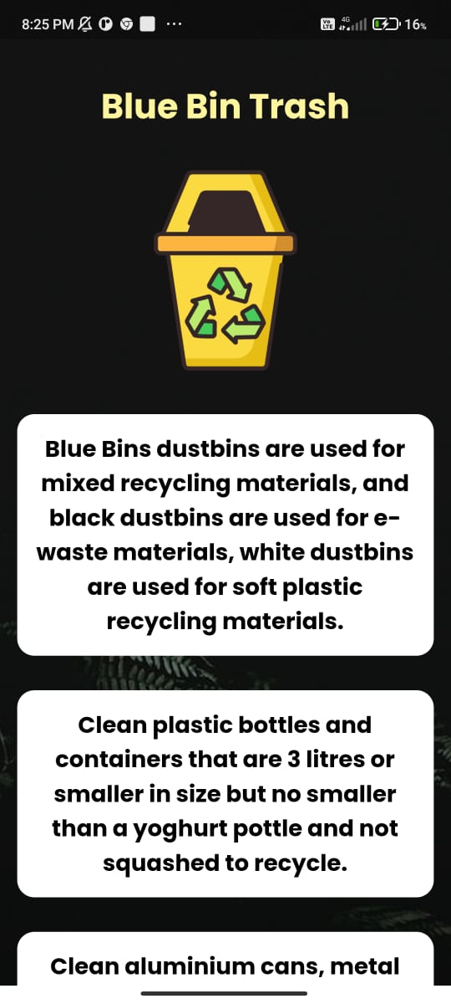
BLUE BIN:
Blue dustbin contains non-biodegradable waste. Blue dustbin contains all the material that is required to be recycled. Material that can be thrown into blue bins is metal, chemicals, plastic, aluminium cans, etc.

Slide 20
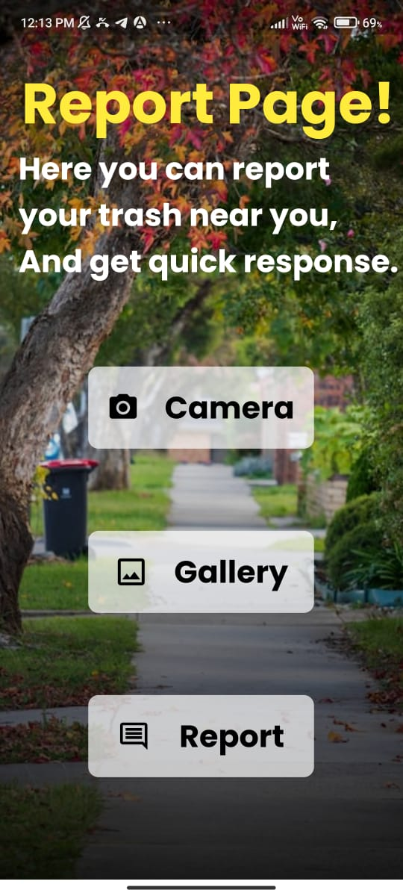
REPORT PAGE:
A report page is a document that presents information in an organized format for a specific audience and purpose. Although summaries of complete reports are almost always in the form of written documents

Slide 21
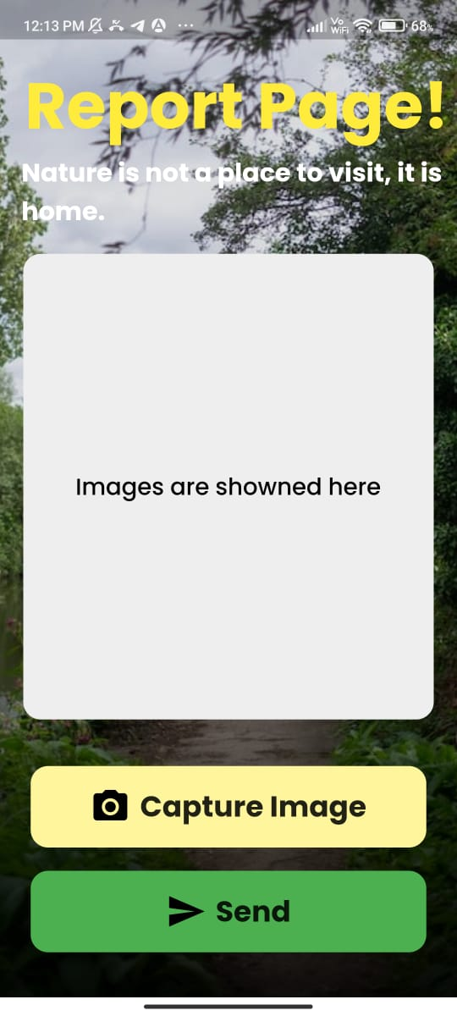
REPORT PAGE(through camera):
This page is report through camera page ,
By clicking the capture image option u will be connected to ur camera ,here you take the garbage pic and you will send to the concern database.
Finally your report will be registered in database.

Slide 22
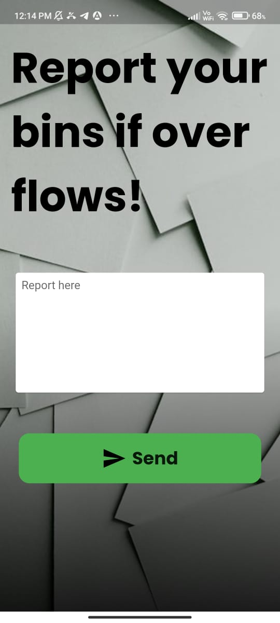
REPORT PAGE(through message):
Through this report by message page the citizens can send their issues in message through texts to the database.

Slide 23
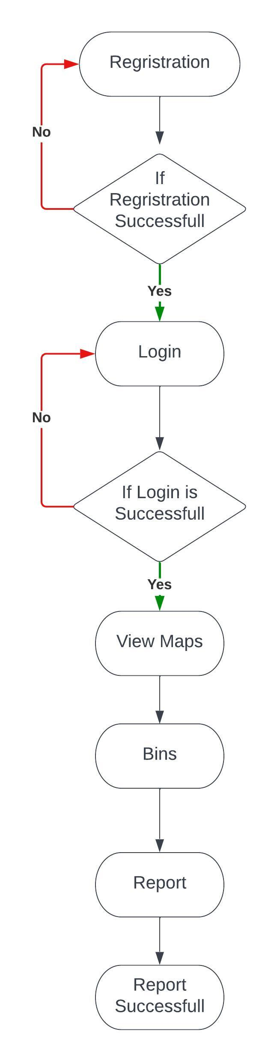
DATA FLOW DIAGRAM:
THIS IS DEMONSTRATION OF A DATA FLOW THROUGH DIAGRAM.

Slide 24
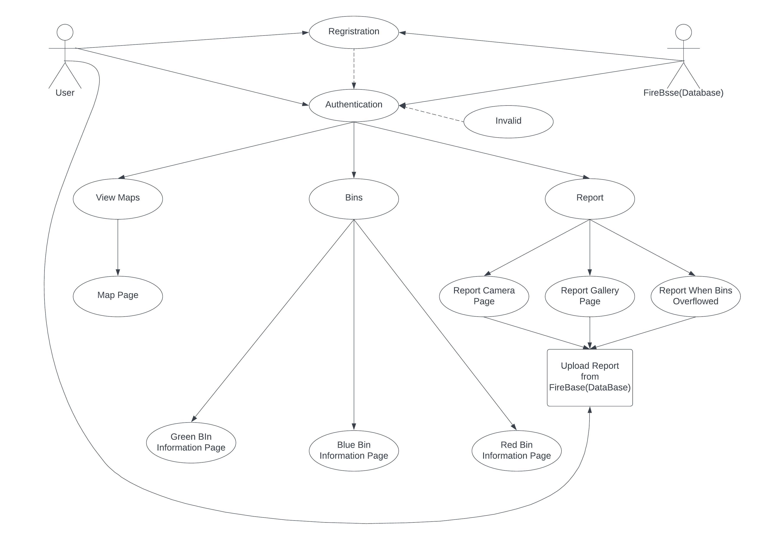
USE CASE DIAGRAM:
THIS IS DEMONSTRATION OF AN USE CASE THROUGH DIAGRAM.

Slide 25
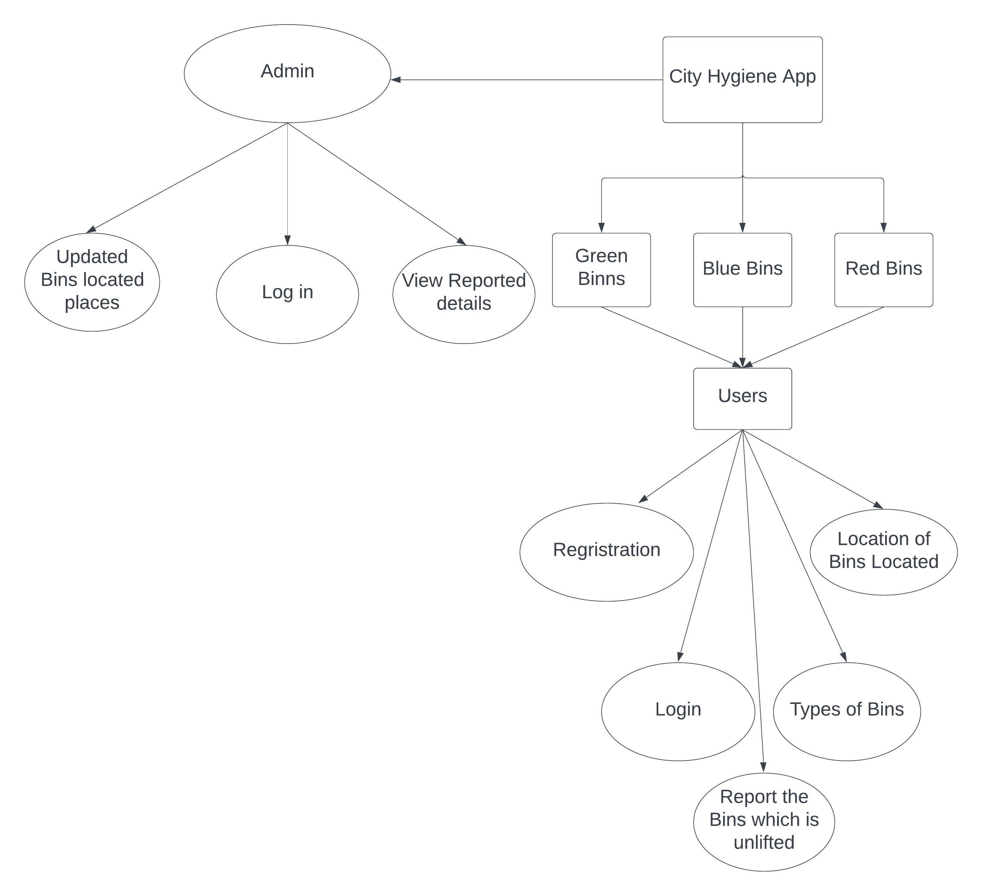
ENTITY RELATIONSHIP DIAGRAM:
THIS IS DEMONSTRATION OF AN ENTITY RELATIONSHIP THROUGH DIAGRAM

Slide 26
FUTURE ENHANCEMENT:
Future enhancement to the plan includes the Open Street Map to be replaced by any upcoming new map technology software or Google Map.
There is a lack of payment for purchasing Open Street Map package or Google Map packages. Its package cost is high. It will be rectified in future enhancement
More user friendly Designing.
Flexible.
Easy for Communication.

Slide 27
CONCLUSION:
This City Hygiene Applications would help citizens and authorities to keep the city clean by making the communication between both parties quicker and also help resolve cleanliness-related issues in the city. It will also improve the hygiene of citizens as overflowing garbage bins are the main cause of many harmful diseases.

Slide 28

Thank you everyone!

